Slide 1
Computer Misuse and Criminal Law Lecture 9

Slide 2
What is Computer Misuse?
Accessing or doing something illegally by using computer.

Slide 3
Types of Computer Misuse
Hacking
Data misuse and unauthorized transfer or copying
Copying and distributing copyrighted software, music and movies
Email and chat room abuses
Identity and financial abuses
Fraud and theft
Viruses

Slide 4
Hacking
Hacking is where an unauthorized person uses a network connection to gain access to main computer without password or other security to see data stored on computer. Hackers sometimes use hacking tools to get into the targets.
For example use different tools to get into server on which websites are running.

Slide 5
Data Misuse and Unauthorized Transfer or Copying
Copying and illegal transfer of data is very quick and easy using online computers and large storage devices such as hard disks, memory sticks and DVDs. Personal data, company research and written work, such as novels and textbooks, cannot be copied without the copyright holder's permission.

Slide 6
Copying and Distributing Copyrighted Software, Music and Movies
This includes copying music and movies with computer equipment and distributing it on the Internet without the copyright holder's permission. This is a widespread misuse of both computers and the Internet that breaks copyright regulations.

Slide 7
Email and Chatroom Abuses
Internet services such as chat rooms and email have been the subject of many well-publicised cases of impersonation and deception where people who are online pretend to have a different identity. Chat rooms have been used to spread rumors about well known personalities. A growing area of abuse of the Internet is email spam, where millions of emails are sent to advertise both legal and illegal products and services.

Slide 8
Identity and Financial Abuses
This topic includes misuse of stolen or fictional credit card numbers to obtain goods or services on the Internet, and use of computers in financial frauds.
These can range from complex well thought out deceptions to simple uses such as printing counterfeit money with color printers.

Slide 9
Fraud and Theft
Dealing or stealing of personal information and money by providing others wrong things or contents on the internet.
Example
Selling the cheap things on the internet by displaying (pictures) things in expensive way.

Slide 10
Viruses
Viruses are relatively simple programs written by people and designed to cause nuisance or damage to computers or their files.

Slide 11
The Computer Misuse Act
The Computer Misuse Act 1990 (CMA) is an act of the UK Parliament passed in 1990. CMA is designed to frame legislation and controls over computer crime and Internet fraud. The legislation was created to:
Criminalize unauthorized access to computer systems.
Deter serious criminals from using a computer in the commission of a criminal offence or seek to hinder or impair access to data stored in a computer

Slide 12
This Act includes 3 criminal offences:
Accessing computer material without permission
For example, looking at someone else's files.
Accessing computer material without permission with intent to commit further criminal offences.
For example, hacking into the bank's computer and wanting to increase the amount in your account.
Altering computer data without permission.
For example, writing a virus to destroy someone else's data, or actually changing the money in an account.

Slide 13
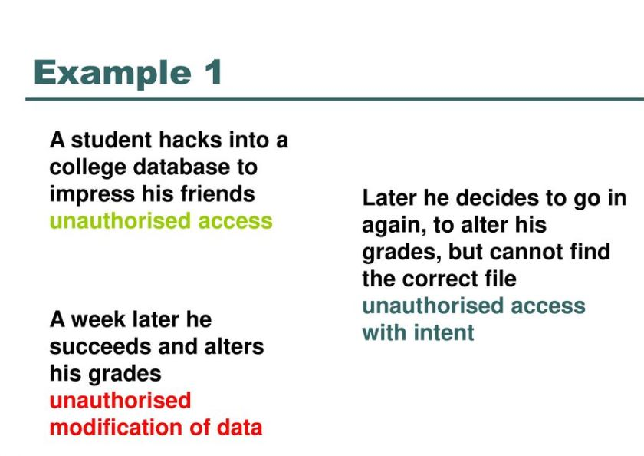

Slide 14
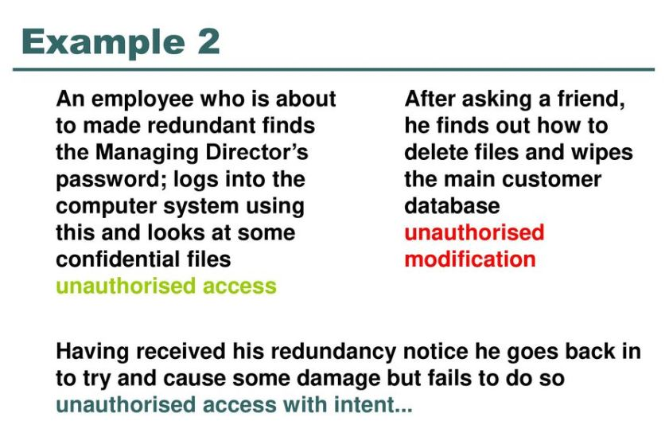

Slide 15
Punishment
The offences are punishable as follows:
Offence 1. Up to 6 months' prison and up to £5,000 in fines.
Offences 2 and 3. Up to 5 years in prison and any size of fine (there is no limit).

Slide 16
Prevention of Computer Misuse
The Data Protection Act
Copyright law
Close down chat rooms

